Slide 1
Welcome

Slide 2
Johora Binte Abedin
Instructor( English)
Narayangong Govt. Technical
School and College.
Class:Six
Subject:English
Present:40
Absent:5
Class Duration:40 Minutes
Date:17-2-2023

Slide 3
Learning Outcome:
.Ask and answer questions
.Read and understand written instructions
.Read and understand texts

Slide 4
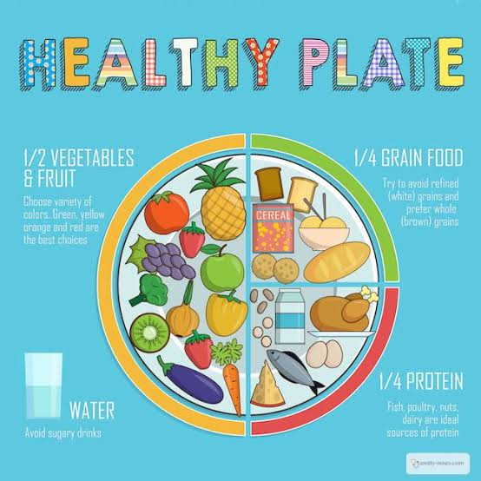

Slide 5
Thank you.

